Slide 1
Dungeons, Dragons & Functions
An Unexpected Journey

Slide 2
Darkness. Humidity. More darkness.
You have been wandering in these caves for days now, searching for the legendary Hammer of Lambda – and found nothing so far.
You enter a large room, of typical Dwarven architecture. In the distance, beyond rows and rows of pillars, a bonfire flickers, illuminating a tall archway, and the silhouette of a creature that appears to be standing guard.

Slide 3
… what do you do?

Slide 4
Role Playing Games (RPGs)
The telling of an Epic Story
You decide

Slide 5

Origin Story
@brandewinder
brandewinder.com

Slide 6
Our campaign
What is D&D?
Modeling Monsters with F#
Roll 20! Modeling Dice
Simulating Combat in Fable-Elmish

Slide 7
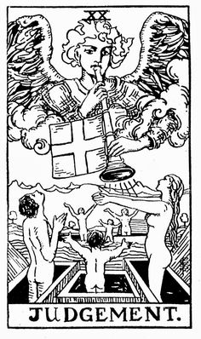
Rules
Smokey, this is not Nam, this is bowling.
There are rules.

Slide 8
Agency
Agency is the capacity of an actor to act in a given environment

Slide 9
What makes a game interesting?
Decisions have consequences
Consequences are not entirely random

Slide 10
Dungeons and Dragons, a.k.a D&D
First published in 1974
Many iterations, current version D&D 5e
First Role-Playing Game (RPG)
Tolkien-inspired universe

Slide 11
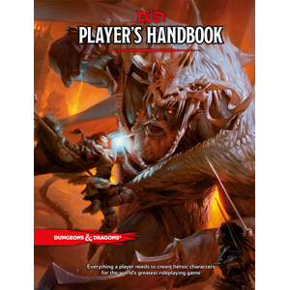
Player’s Handbook (PHB)
316 pages
Basic rules: 180 (free)

Slide 12
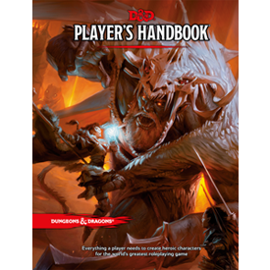
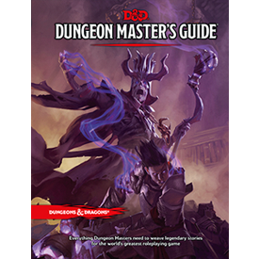
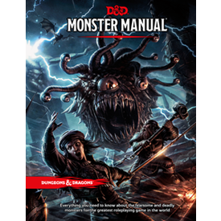
PHB (316), DMG (320), MM (352)

Slide 13
Playing D&D
2 roles: Players, Dungeon Master (DM)
Players decide what they want to do
DM runs the world around them
2 slightly different phases
Role play: flexible, focus is on interactions
Combat: rigid, turn-based wargame

Slide 14
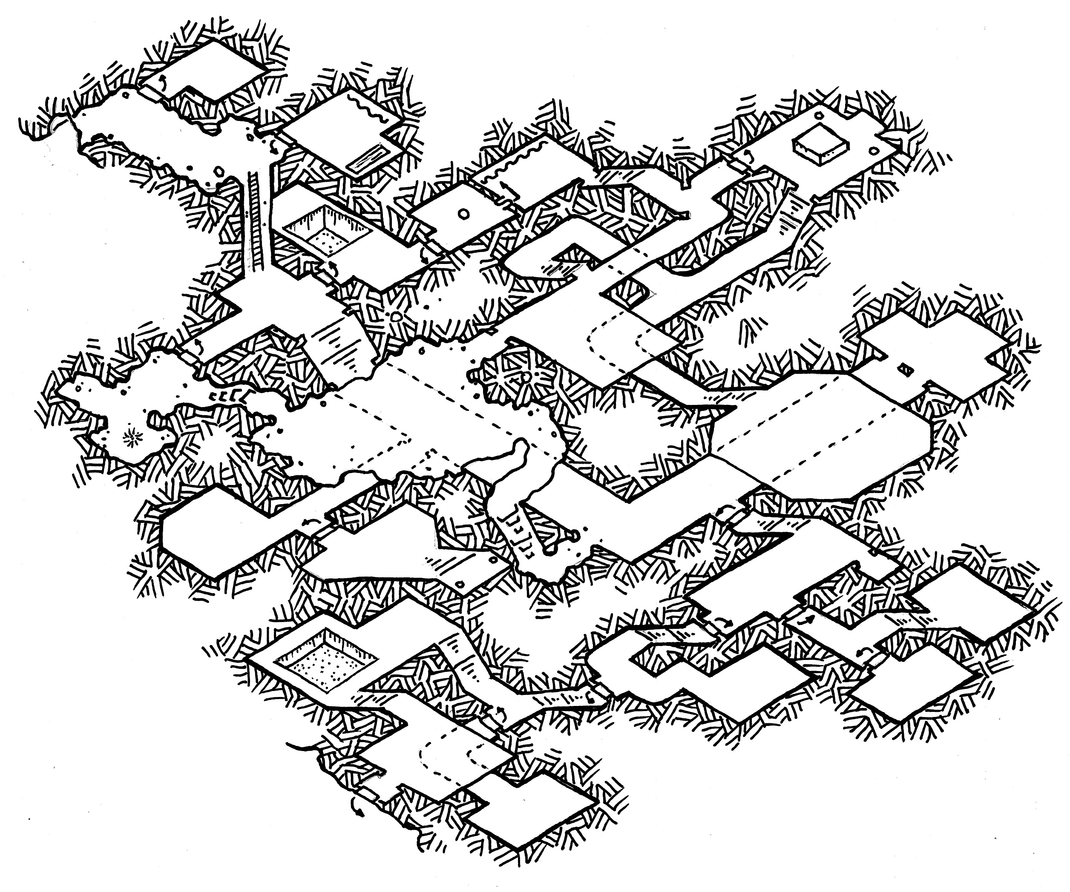
Domain Modelling
Source: Dyson Logos

Slide 15
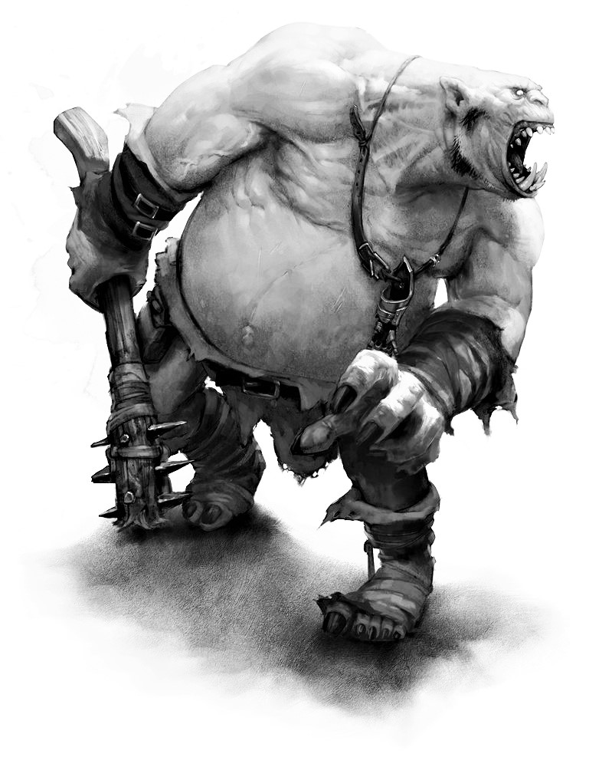
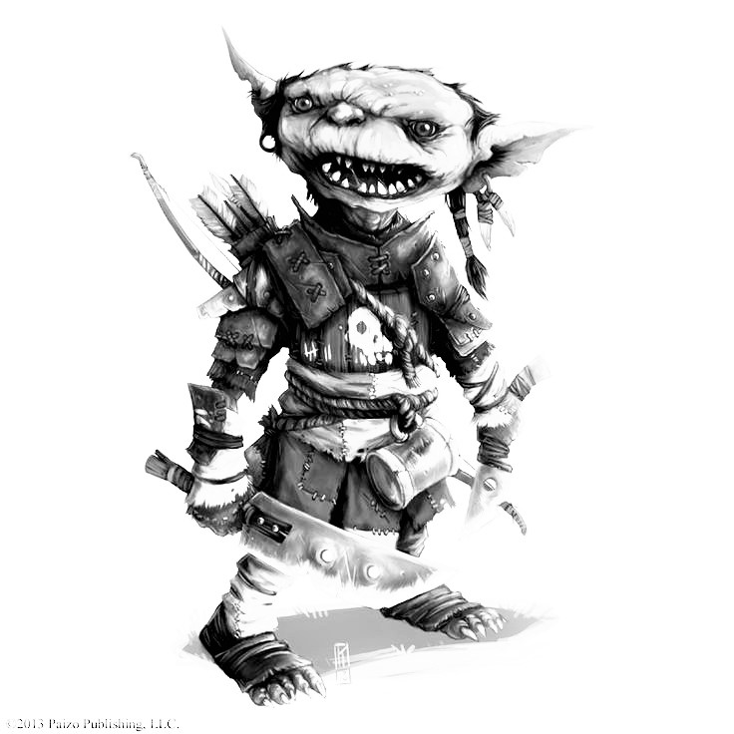
Ogres, Goblins, & Company

Slide 16
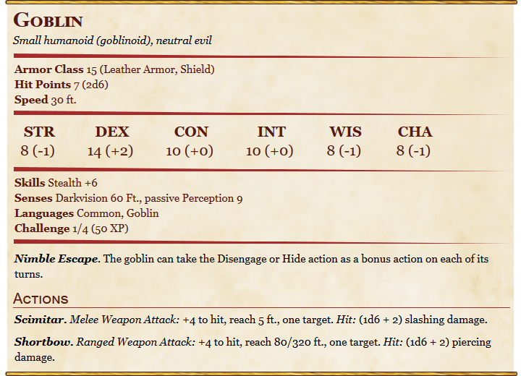

Slide 17
Abilities
“6 abilities provide a quick description of every creature’s physical and mental characteristics: Strength, Dexterity, Constitution, Intelligence, Wisdom, Charisma”
PHB, p173

Slide 18
Discriminated Union
type Ability =
| STR
| DEX
| CON
| INT
| WIS
| CHA

Slide 19
Abilities
“Each of a creature’s ability has a score, a number that defines the magnitude of that ability.”
PHB, p173

Slide 20
Record
type Scores = {
STR: int
DEX: int
CON: int
INT: int
WIS: int
CHA: int
}

Slide 21
Pattern Matching
let score (scores: Scores) (ability: Ability) =
match ability with
| STR -> scores.STR
| DEX -> scores.DEX
| CON -> scores.CON
…

Slide 22
Pipe forward
let goblin = {
STR = 8
DEX = 14
CON = 10
INT = 10
WIS = 8
CHA = 8
}
score DEX goblin
goblin |> score DEX

Slide 23
“Each ability also has a modifier. To determine the modifier […], substract 10 from the ability score and divide the total by 2 (rounded down).”

Slide 24
Function
let modifier (score: int) = (score - 10) / 2

Slide 25
let goblin = {
STR = 8
DEX = 14
CON = 10
INT = 10
WIS = 8
CHA = 8
}
modifier (score DEX goblin)
let dexterityBonus =
goblin
|> score DEX
|> modifier

Slide 26
Algebraic Data Types
“a kind of composite type, formed by combining other types” (Wikipedia)
Sum Types (OR): Discriminated Union
Product Types (AND): Records, Tuples

Slide 27
Level Up!

Slide 29
Ubiquitous Language
Sections?
Titles?
Lists?
Names?
Similarities, differences?

Slide 31
A Language Mess
Scimitars, shortbows are not Actions
A Weapon is not an Attack
A Weapon can be used to make an Attack
Beware of potential ambiguities

Slide 32
Goblin attacks
Scimitar. Melee Weapon Attack: +4 to hit, reach 5 ft., one target. Hit: (1d6 + 2) slashing damage.
Shortbow. Ranged Weapon Attack: +4 to hit, reach 80/320 ft., one target. Hit: (1d6 + 2) piercing damage.

Slide 33
Common structure: record / AND
Scimitar.
Melee Weapon Attack:
+4 to hit,
reach 5 ft.,
one target.
Hit: (1d6 + 2) slashing damage.
Shortbow.
Ranged Weapon Attack:
+4 to hit,
reach 80/320 ft.,
one target.
Hit: (1d6 + 2) piercing damage.

Slide 34
Different structure: OR
Scimitar.
Melee Weapon Attack:
+4 to hit,
reach 5 ft.,
one target.
Hit: (1d6 + 2) slashing damage.
Shortbow.
Ranged Weapon Attack:
+4 to hit,
reach 80/320 ft.,
one target.
Hit: (1d6 + 2) piercing damage.

Slide 35
Melee & Ranged
“Every weapon is classified as either melee or ranged. A melee weapon is used to Attack a target within 5 feet of you, whereas a ranged weapon is used to Attack a target at a distance.”
PHB, p146

Slide 36
“A weapon that can be used to make a ranged Attack has a range in parentheses […]. The range lists two numbers. The first is the weapon’s normal range in feet, and the second indicates the weapon’s long range.”
PHB, p147

Slide 37
Attack: a sketch
type Attack = {
Description: string
“Type”?: ? (Melee | Ranged)
Hit Bonus: int
Reach: (5 ft. | 80/320 ft.)
Targets: int
Damage: Dice Roll * Damage Type
}

Slide 38
// reach can have different shapes & data
type Reach =
| Melee of int
| Ranged of int * int
type Attack = {
Reach: Reach
…
}

Slide 39
Pattern Match to extract data
type Reach =
| Melee of int
| Ranged of int * int
let maximumReach (attack: Attack) =
match attack.Reach with
| Melee reach -> reach // data is an integer
| Ranged (short, long) -> long // data is a tuple

Slide 40
type RangedReach = { Short: int; Long: int }
type Reach =
| Melee of int
| Ranged of RangedReach
let maximumReach (attack: Attack) =
match attack.Reach with
| Melee reach -> reach // data is an integer
| Ranged reach -> reach.Long // data is a record

Slide 41
module Ranged =
type Reach = { Short: int; Long: int }
type Reach =
| Melee of int
| Ranged of Ranged.Reach

Slide 42
Problem: which is it?
let wat = {
Type = Melee
Reach = Ranged { Short = 10; Long = 20 }
…
}

Slide 43
“Make impossible states un-representable”
Symptom: exception in pattern matches
… Exceptions in general

Slide 44
let shortBow: Attack = {
Description = “Shortbow”
Reach = Ranged { Short = 10; Long = 20 }
Hit Bonus = 4
Damage = 1d6 + 2, Piercing
}

Slide 45
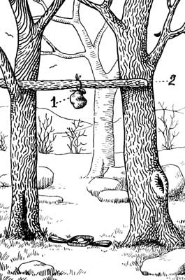
Traps

Slide 46
The domain is well documented
… It should be easy to implement

Slide 47
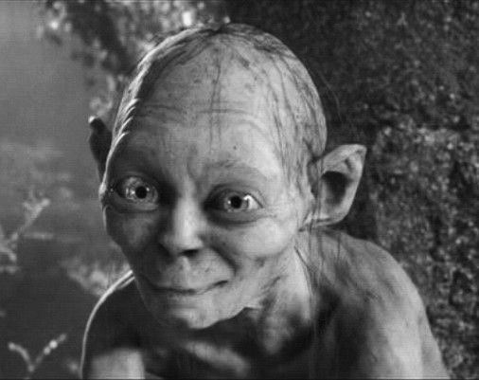
Lies, damned lies, and specifications
The specification is full of lies half-truths

Slide 48
Goblin attacks
Scimitar. Melee Weapon Attack: +4 to hit, reach 5 ft., one target. Hit: (1d6 + 2) slashing damage.
Shortbow. Ranged Weapon Attack: +4 to hit, reach 80/320 ft., one target. Hit: (1d6 + 2) piercing damage.

Slide 49
Wyvern attacks
Stinger. Melee Weapon Attack: +7 to hit, reach 10 ft., one creature. Hit: (2d6 + 4) piercing damage. The target must make a DC 15 Constitution saving throw, taking 24 (7d6) poison damage on a failed save, or half as much damage on a successful one

Slide 50
True means “usually true”
Stinger. Melee Weapon Attack: +7 to hit, reach 10 ft., one creature. Hit: (2d6 + 4) piercing damage. The target must make a DC 15 Constitution saving throw, taking 24 (7d6) poison damage on a failed save, or half as much damage on a successful one

Slide 51
One, or “At least one”?
Stinger. Melee Weapon Attack: +7 to hit, reach 10 ft., one creature. Hit: (2d6 + 4) piercing damage. The target must make a DC 15 Constitution saving throw, taking 24 (7d6) poison damage on a failed save, or half as much damage on a successful one

Slide 52
type Damage = {
Damage: Dice Roll
Type: Damage Type // Piercing, Poison, …
}
type Attack = {
Damage: list<Damage>
}

Slide 53
One, or “Maybe one”?
Stinger. Melee Weapon Attack: +7 to hit, reach 10 ft., one creature. Hit: (2d6 + 4) piercing damage. The target must make a DC 15 Constitution saving throw, taking 24 (7d6) poison damage on a failed save, or half as much damage on a successful one

Slide 54
type Damage = {
Damage: Dice Roll
Type: Damage Type // Piercing, Poison, …
SpecialStuff: Option<SpecialStuff>
}

Slide 55
Light, Heavy Weapons
Heavy: […] a heavy weapon’s size and bulk make it too large for a small creature to use effectively.
Light: a light weapon is small and easy to handle […].
PHB, p147

Slide 56
type Weight =
| Light
| Heavy
type Weapon = {
Weight: Weight
…
}

Slide 57
The truth…
… all the truth, & nothing but the truth
Mutually Exclusive, Collectively Exhaustive
Light | Heavy?
None | Some (Light | Heavy)
Light | Medium | Heavy

Slide 58
Is it really closed?
List, or Discriminated Union?
DU is not extensible

Slide 59
Composition
Straightforward composition principle
“Composition over Inheritance”
F# helps ask the right questions

Slide 60
Questions to ask
One, or “At least one”?
One, or “Maybe one”?
Harder to spot!
Is it really closed?
Are all cases included?

Slide 61
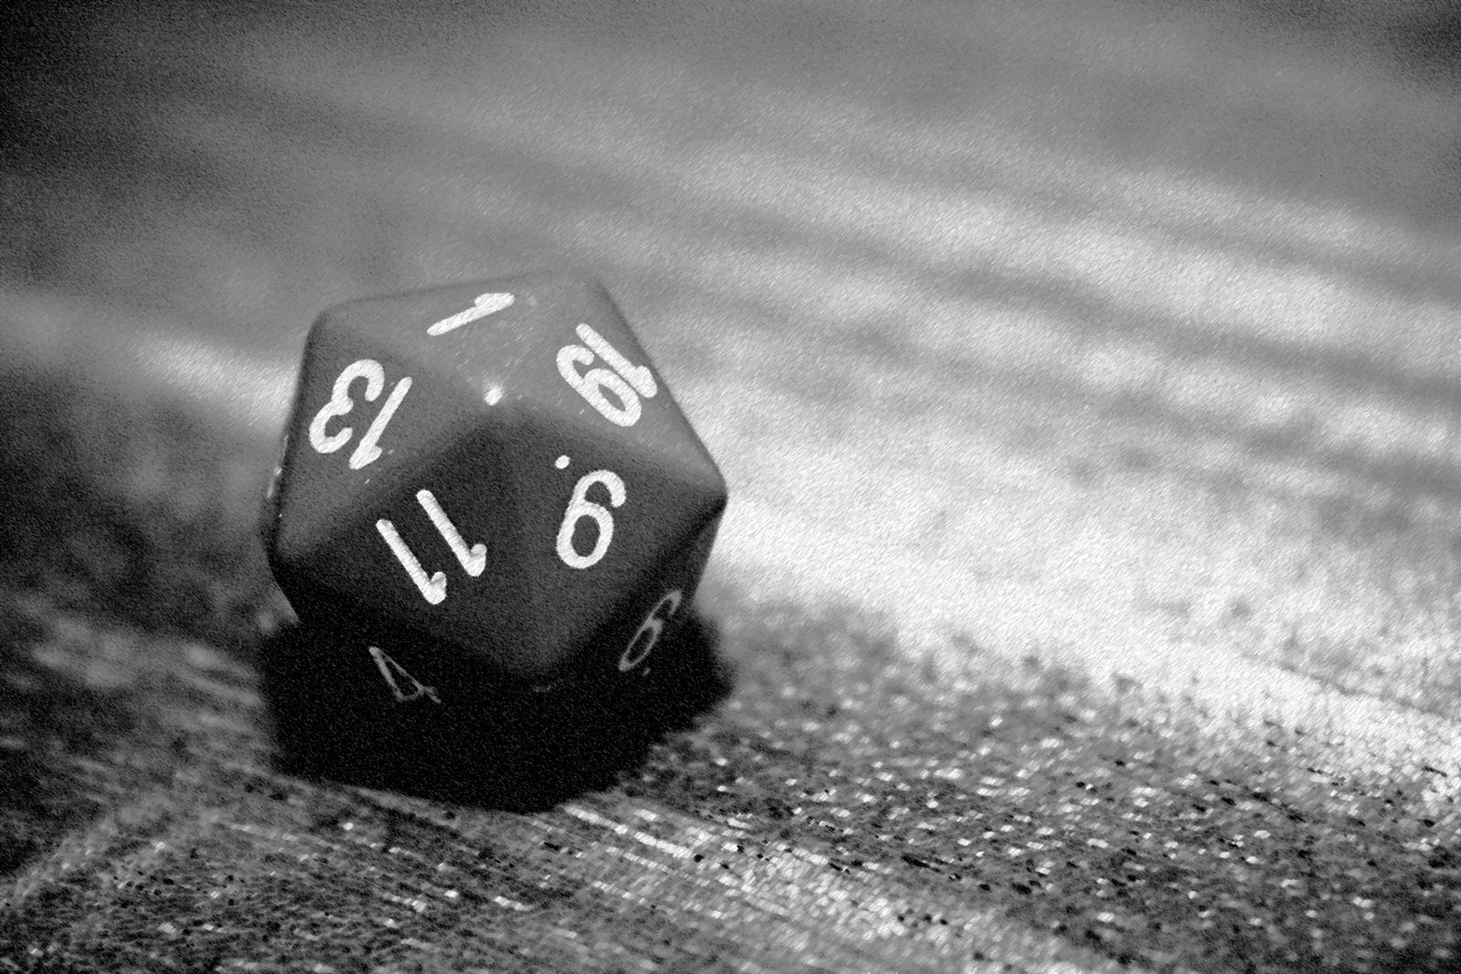
Dice Rolls
Roll 20!
Source: Scott Ogle / Wikimedia

Slide 62
let shortBow: Attack = {
Description = “Shortbow”
Reach = Ranged { Short = 10; Long = 20 }
Hit Bonus = 4
Damage = 1d6 + 2, Piercing
}

Slide 63
Dice are everywhere
Permeate the rules, have their own syntax
d4, d6, d8, d10, d12, d20, d100
5d10 + 15 + 2d4

Slide 64
We would like something like…
let attack = 1d20
let damage = 4d10 + 2d6 + 4

Slide 65

Tomas Petricek
Legendary Half-Elf Wizard
INT 18 (+4)
@tomaspetricek

Slide 66
What we would like
let damage = 4d10 + 2d6 + 4
Arbitrarily complex Expression, containing:
Rolls: “roll a 10-sided dice, 4 times”
Integer Values: “4”
Can be added together

Slide 67
Let’s try that out

Slide 68
Internal DSL / Expressions
type Dice = | D of int // let d6 = D 6
type DiceRoll =
| Roll of int * Dice // primitive value
| Value of int // primitive value
| Add of list<DiceRoll> // recursive combination
Add [ Roll (4, D 20); Add [ Roll (2, D 6); Value 8 ]]

Slide 69
Evaluation
let rec eval (roll: DiceRoll) =
match roll with
| Roll (times, D sides) -> // do stuff
| Value value -> value
| Add rolls ->
rolls |> List.sumBy eval

Slide 70
Comments
Using Expressions + eval more & more
Internal DSL
Type checked with existing language tools
Careful with custom operators
Use methods for overloads
Simplify usage with constructor functions

Slide 71

Fable Elmish

Slide 72
Turns
“On your turn, you can move a distance up to your speed and take one action.”
PHB, p189

Slide 73
type Direction =
| N
| W
| S
| E
type Position = { North: int; West: int }

Slide 74
let move (pos: Position) (dir: Direction) =
match dir with
| N -> { pos with North = pos.North + 1 }
| W -> { pos with West = pos.West + 1 }
| S -> { pos with North = pos.North - 1 }
| E -> { pos with West = pos.West - 1 }

Slide 75
let initial = { North = 0; West = 0 }
initial
|> move N
|> move N
|> move E

Slide 76
type Message =
| Move of Direction
| Action of …
type State = { Position: Position; … }

Slide 77
let update (state: State) (message: Message) =
match message with
| Move direction ->
{ state with
Position = state.Position |> move direction
}
| Action action -> ….

Slide 78
let messages = [ Move N; Move N; Move E ]
initialState
|> update (Move N)
|> update (Move W)
(initialState, messages)
||> List.fold (fun state message -> update)

Slide 79
What is an application?
What can you do?
Message
What changes?
Update: State -> Message -> State
An initial State
Init: () -> State

Slide 80
MVU / Model-View-Update
Message
Init
Model
Update
View

Slide 81
Fable Elmish
Fable: F# to Javascript
Elmish: Model-View-Update
Great fit with Domain Driven Design

Slide 82
Demo

Slide 83
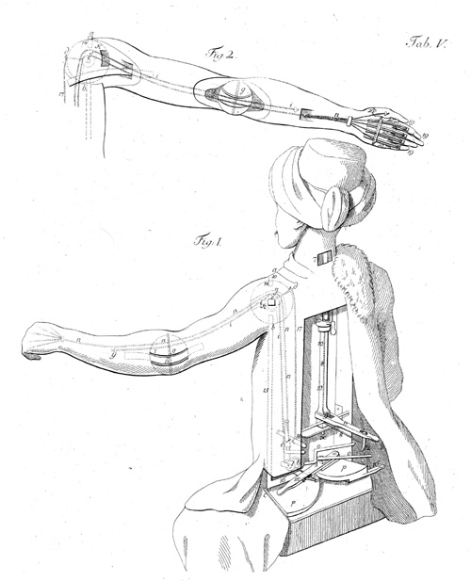
Automata

Slide 84
My real goal
Design fair fights for my D&D campaign
What is the probability of a TPK?

Slide 85
What is a fair fight?
If Players don’t do anything silly,
And Monsters don’t do anything silly,
Probability of survival is “reasonable”

Slide 86
Estimating probability of survival
Simulation!
Play the same fight over and over again
Requires:
implementing rules of the game
automated decision making

Slide 87
Automated Decision Making
Problem: what should creatures do?
First step: what can creatures do?

Slide 88
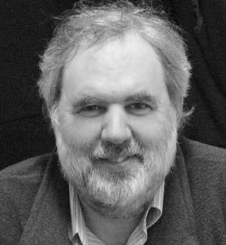
Scott Wlaschin
Legendary Gnome Druid
WIS 18 (+4)
@ScottWlaschin

Slide 89
Representing decisions
Who is making the decision?
What are the alternatives?
What information is available?

Slide 90
Representing Decisions
type DecisionNeeded = {
Creature: CreatureID
Alternatives: list<Action>
Information: Information
}
… Validation is trivial

Slide 91
Message
Init
Model
Update
Decide
Decision
Needed
View

Slide 92
Demo

Slide 93
Conclusion

Slide 94
What’s missing?
Finish implementing the rules!
Effects (buffs & debuffs)
Magic
Terrain, line of sight, cover…

Slide 95
What’s missing?
Smart decisions!
Reinforcement Learning
Play a lot of games
Try a bit of everything
Do more of what works
Do less of what doesn’t work

Slide 96
What makes modeling difficult?
Easy to understand vs. easy to code?
Explaining by examples
Omitting obvious context
“My friend has one head, 2 legs, and 2 arms”
Eagerness to have found the model

Slide 97

Thank You! (Cast “Bless”)
@brandewinder
brandewinder.com
Github repo:
mathias-brandewinder /MonsterVault

Slide 99
Side note
The specification is full of lies half-truths

Slide 100
Turns
“On your turn, you can move a distance up to your speed and take one action.”
PHB, p189

Slide 101
Reactions
“You can make an opportunity attack when a hostile creature that you can see moves out of your reach”
PHB, p195

Slide 102
type WaitingForConfirmation =
| Action of UnconfirmedActionResult
| Reaction of
UnconfirmedReactionResult * WaitingForConfirmation

Slide 103
type Machine =
| CombatFinished of CombatOutcome
| ActionNeeded of ActionNeeded
| ReactionNeeded of
ReactionNeeded * WaitingForConfirmation

